Slide 1


Slide 2
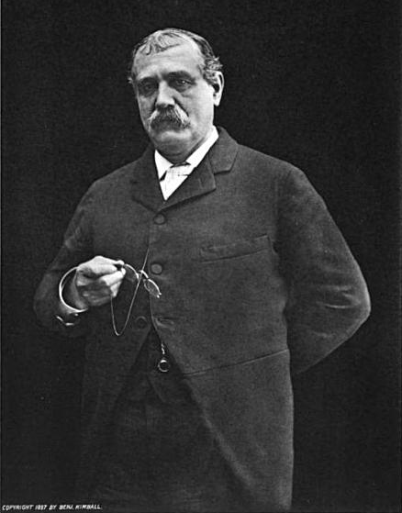
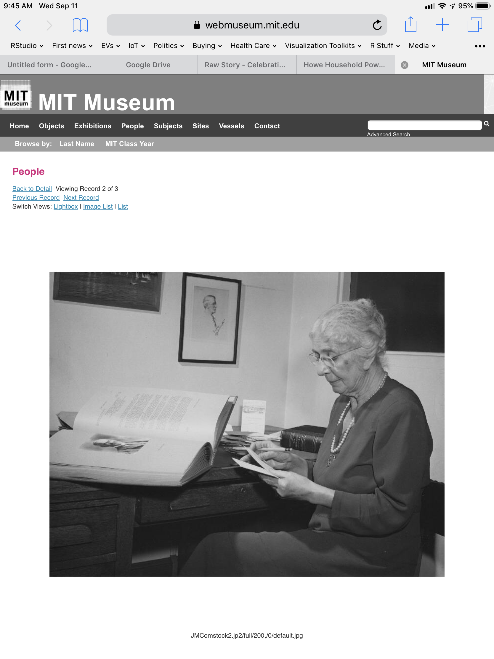
Francis Amasa Walker
Adujunt General of the Union Army
Superintendent of the U.S. Census in 1870 and 1880
3rd President of the Massachusetts Institute of Technology
Julia Comstock
Assistant to 10 MIT Presidents, 1892-1952

Slide 3
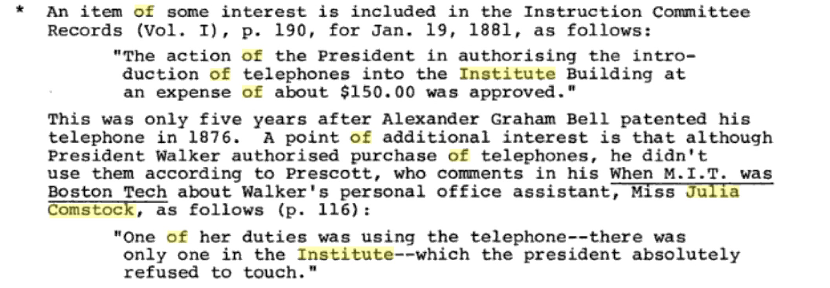

Slide 4

Data Science Education in 2022
Carl Howe, Director of Education
carl@rstudio.com
carlhowe.com

Slide 5
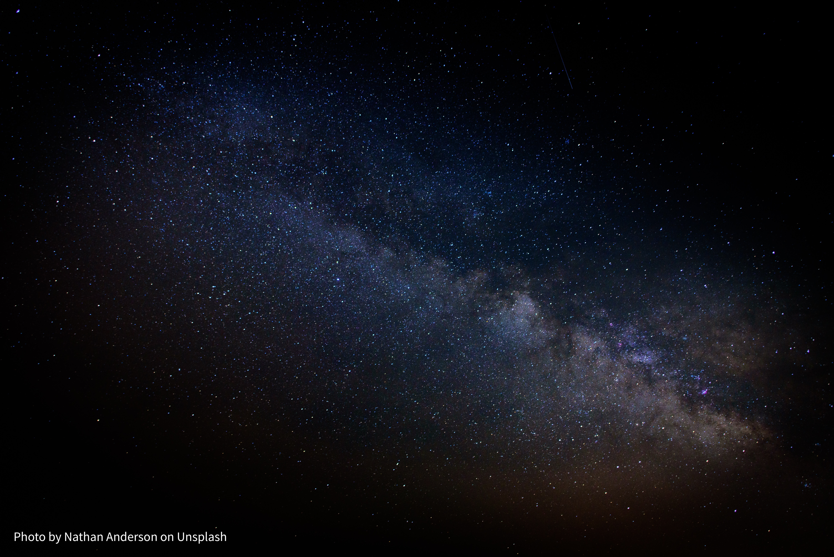

It is difficult to make predictions, especially about the future.
Unattributed Danish parlamentarian,
quoting a Danish proverb, 1937-38

Slide 6


RStudio's Mission:
Equip everyone, regardless of means, to participate in a global economy that rewards data literacy

Slide 7
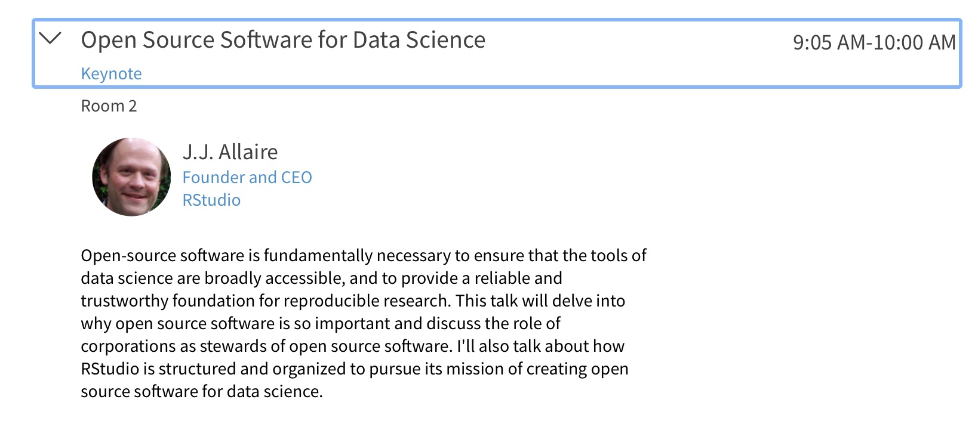
RStudio: A Public Benefit Corporation

Slide 8
RStudio Education's mission:
Train the next million R users
#NextMillionRUsers

Slide 9
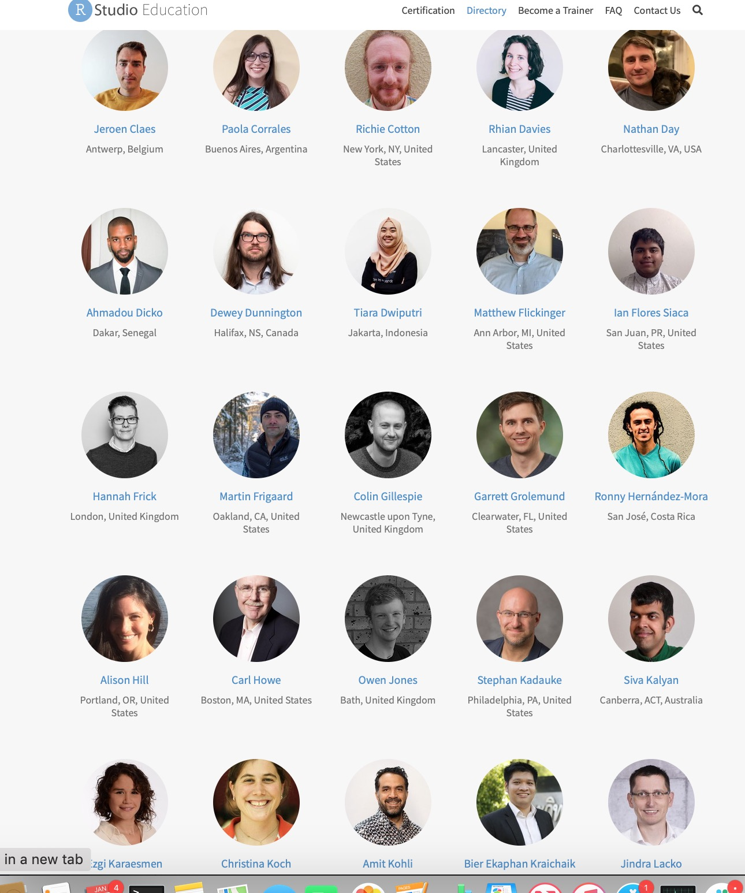
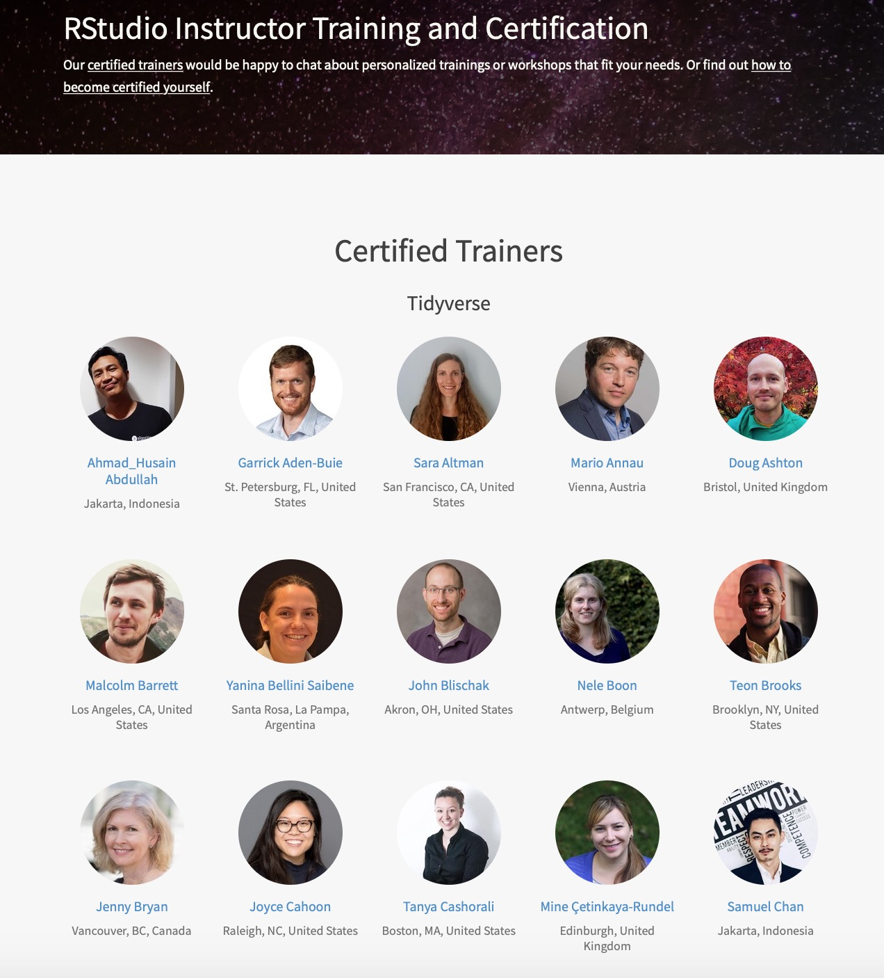
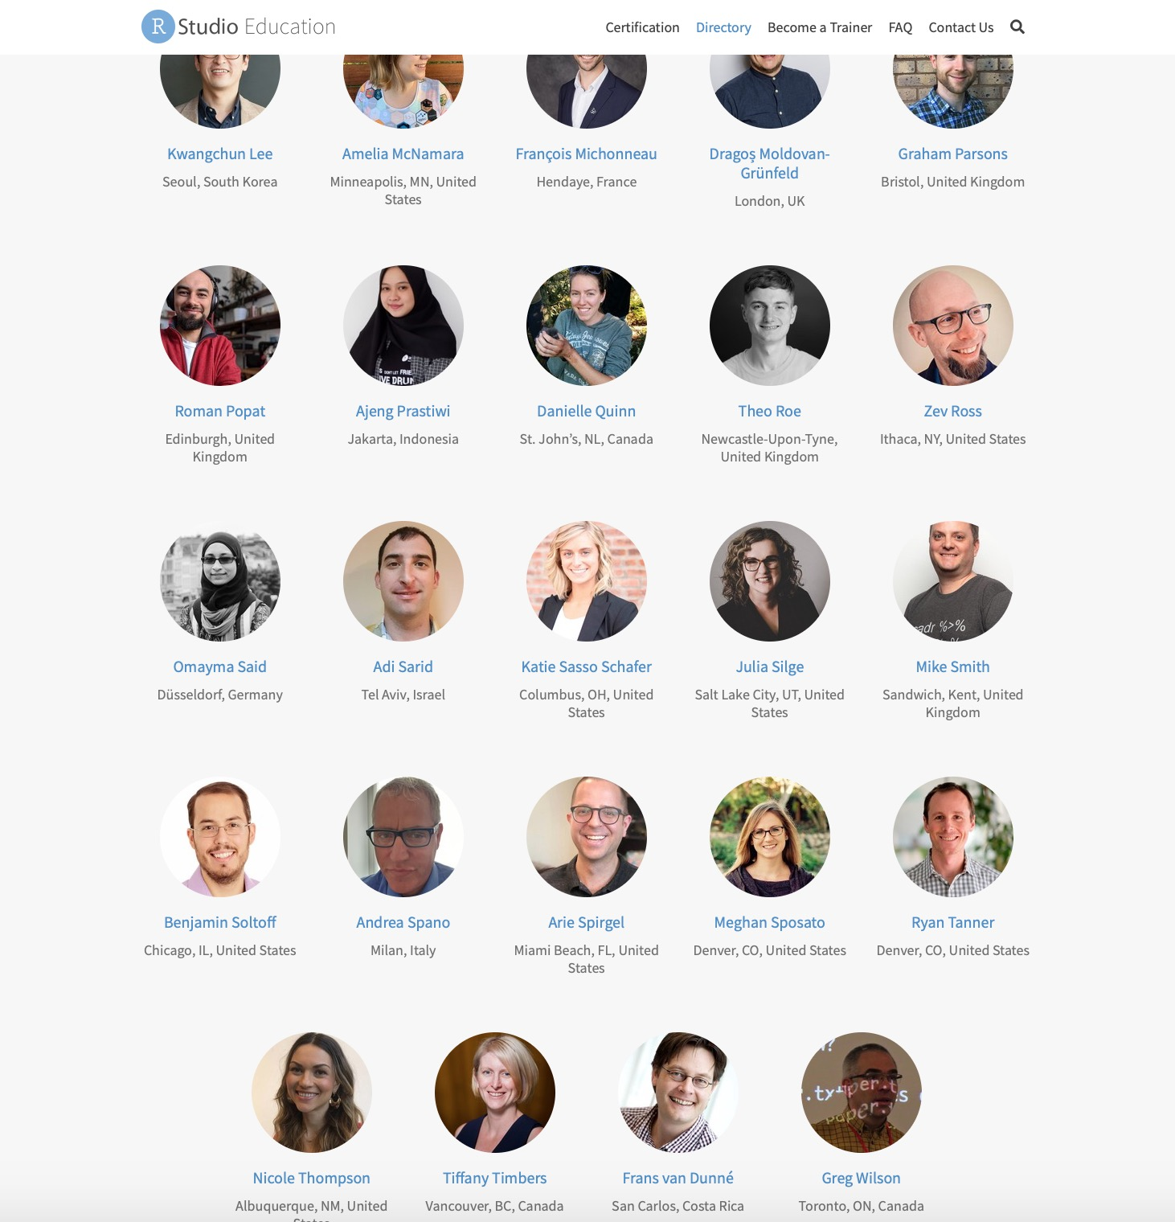
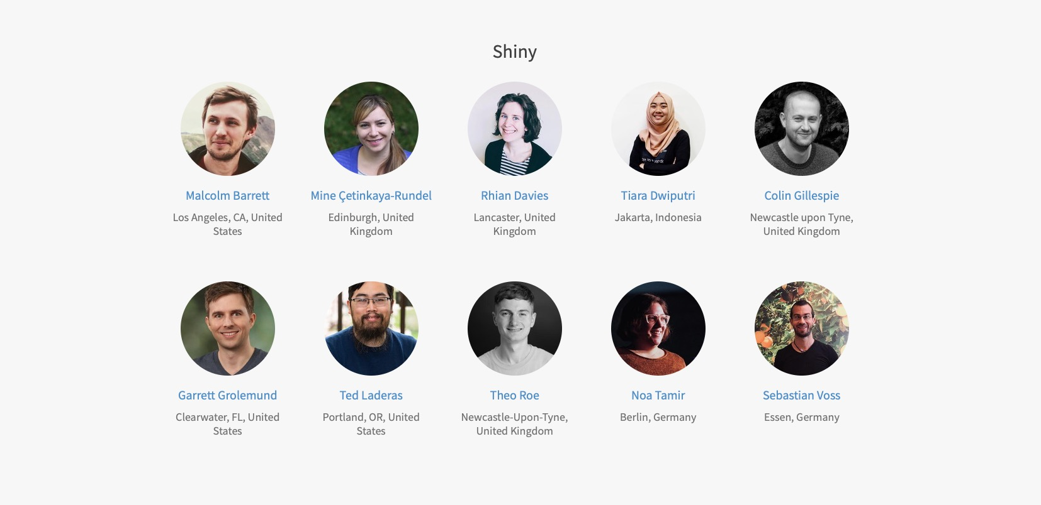
Nearly 100 certified instructors

Slide 10
RStudio::conf 2020
19 Workshops
101 Teaching Staff
1,300+ students
largest R education event in the world

Slide 11
Other RStudio Education Contributions
Free online books
R packages for education
Open source workshop materials on github
Free academic licenses for RStudio Pro products
Annual survey of how people learn R

Slide 12
But that's not nearly enough

Slide 13
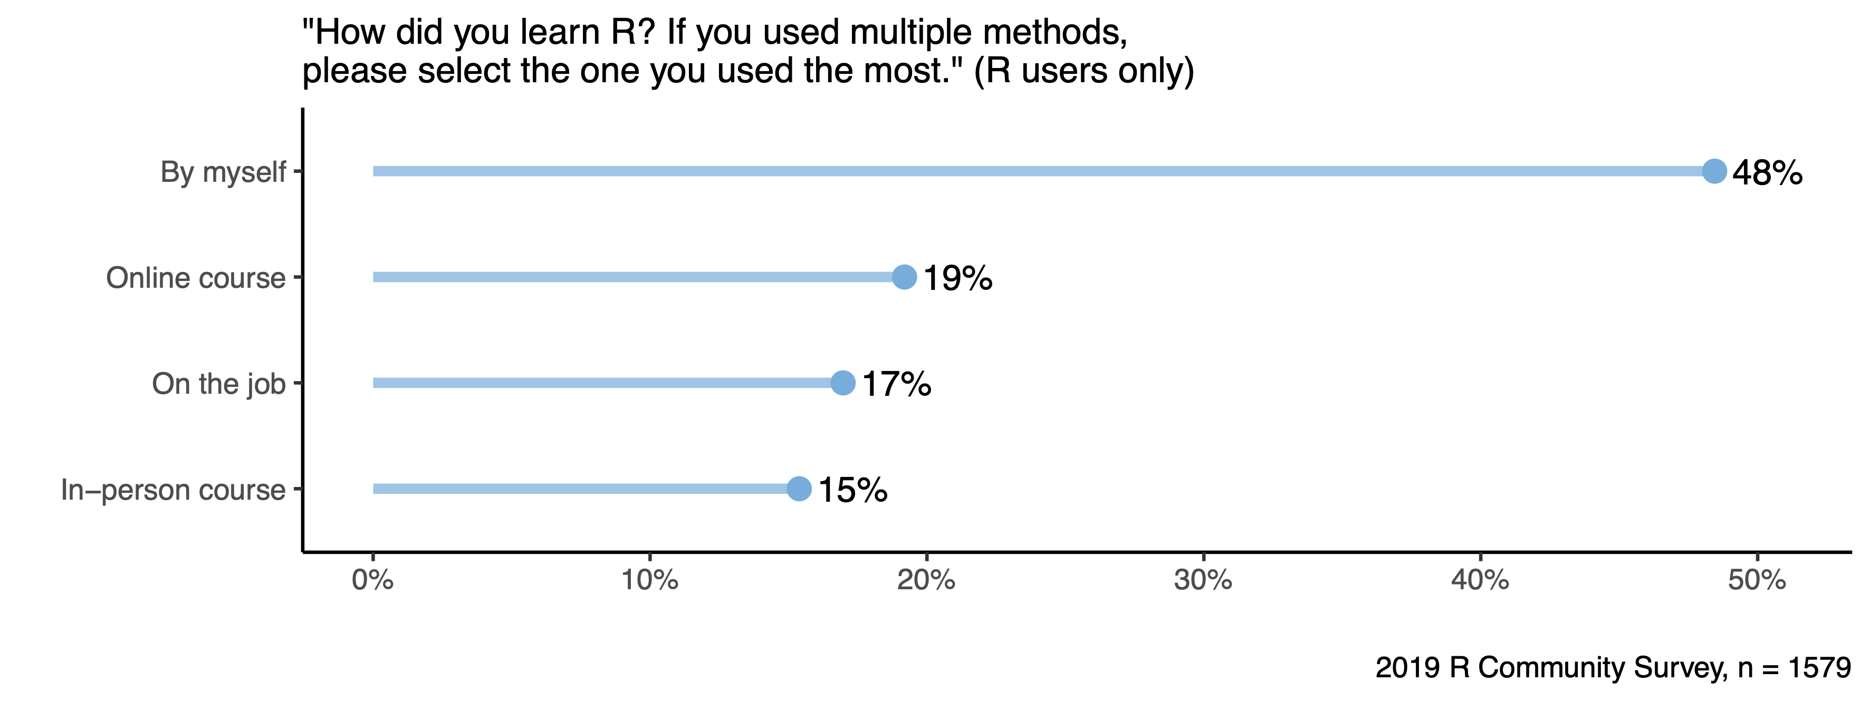
Most R users are self-taught
https://github.com/rstudio/learning-r-survey

Slide 14
Data science education faces serious challenges

Slide 15
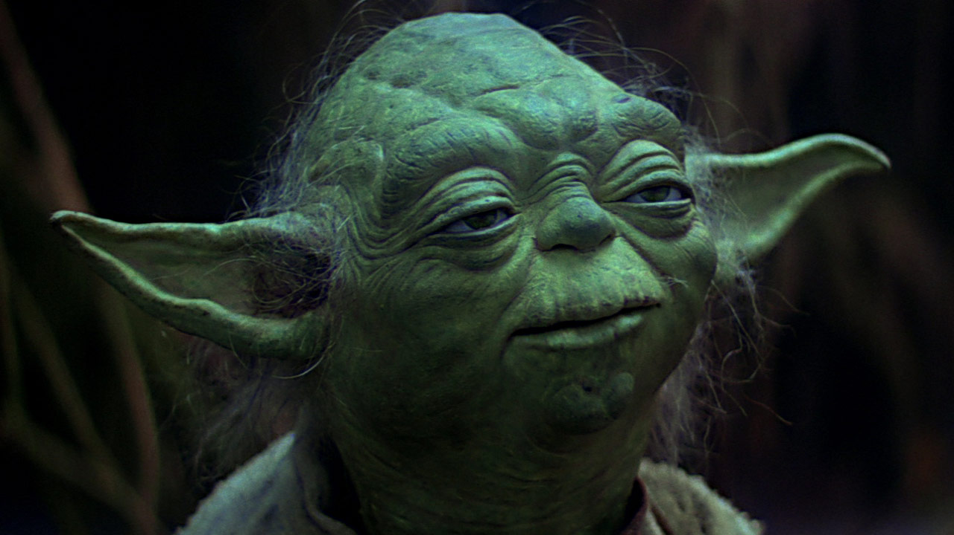
You're not afraid?
You will be.....

Slide 16

Challenges
Data explosion

Slide 17
1. We're drowning in data

Slide 18
"90% of the data in the world was created in the last 2 years"
IBM Marketing Cloud, “10 Key Marketing Trends For 2017

Slide 19
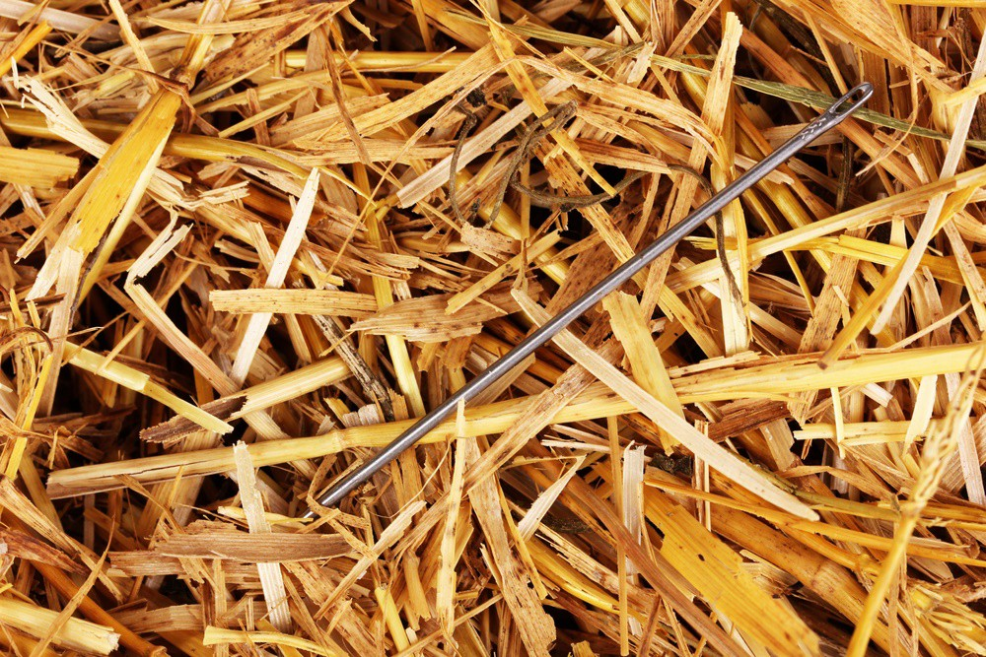

Slide 20
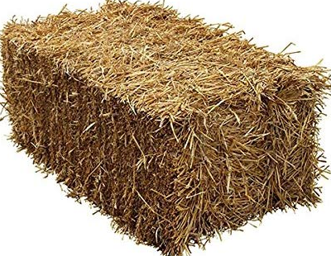
2020
2022
2024

Slide 21
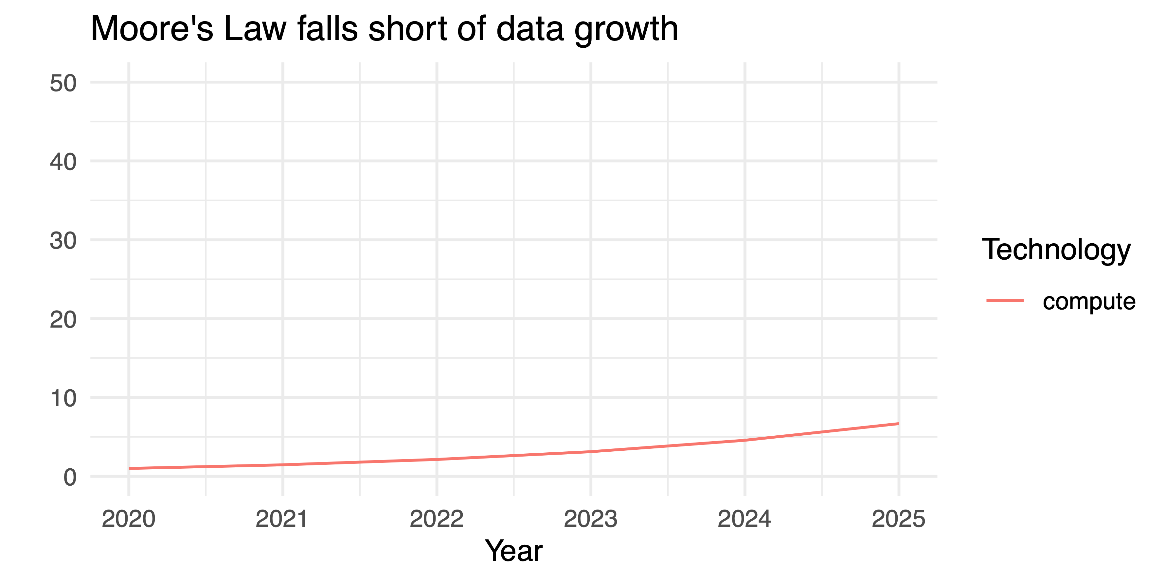
Moore's Law won't bail us out

Slide 22
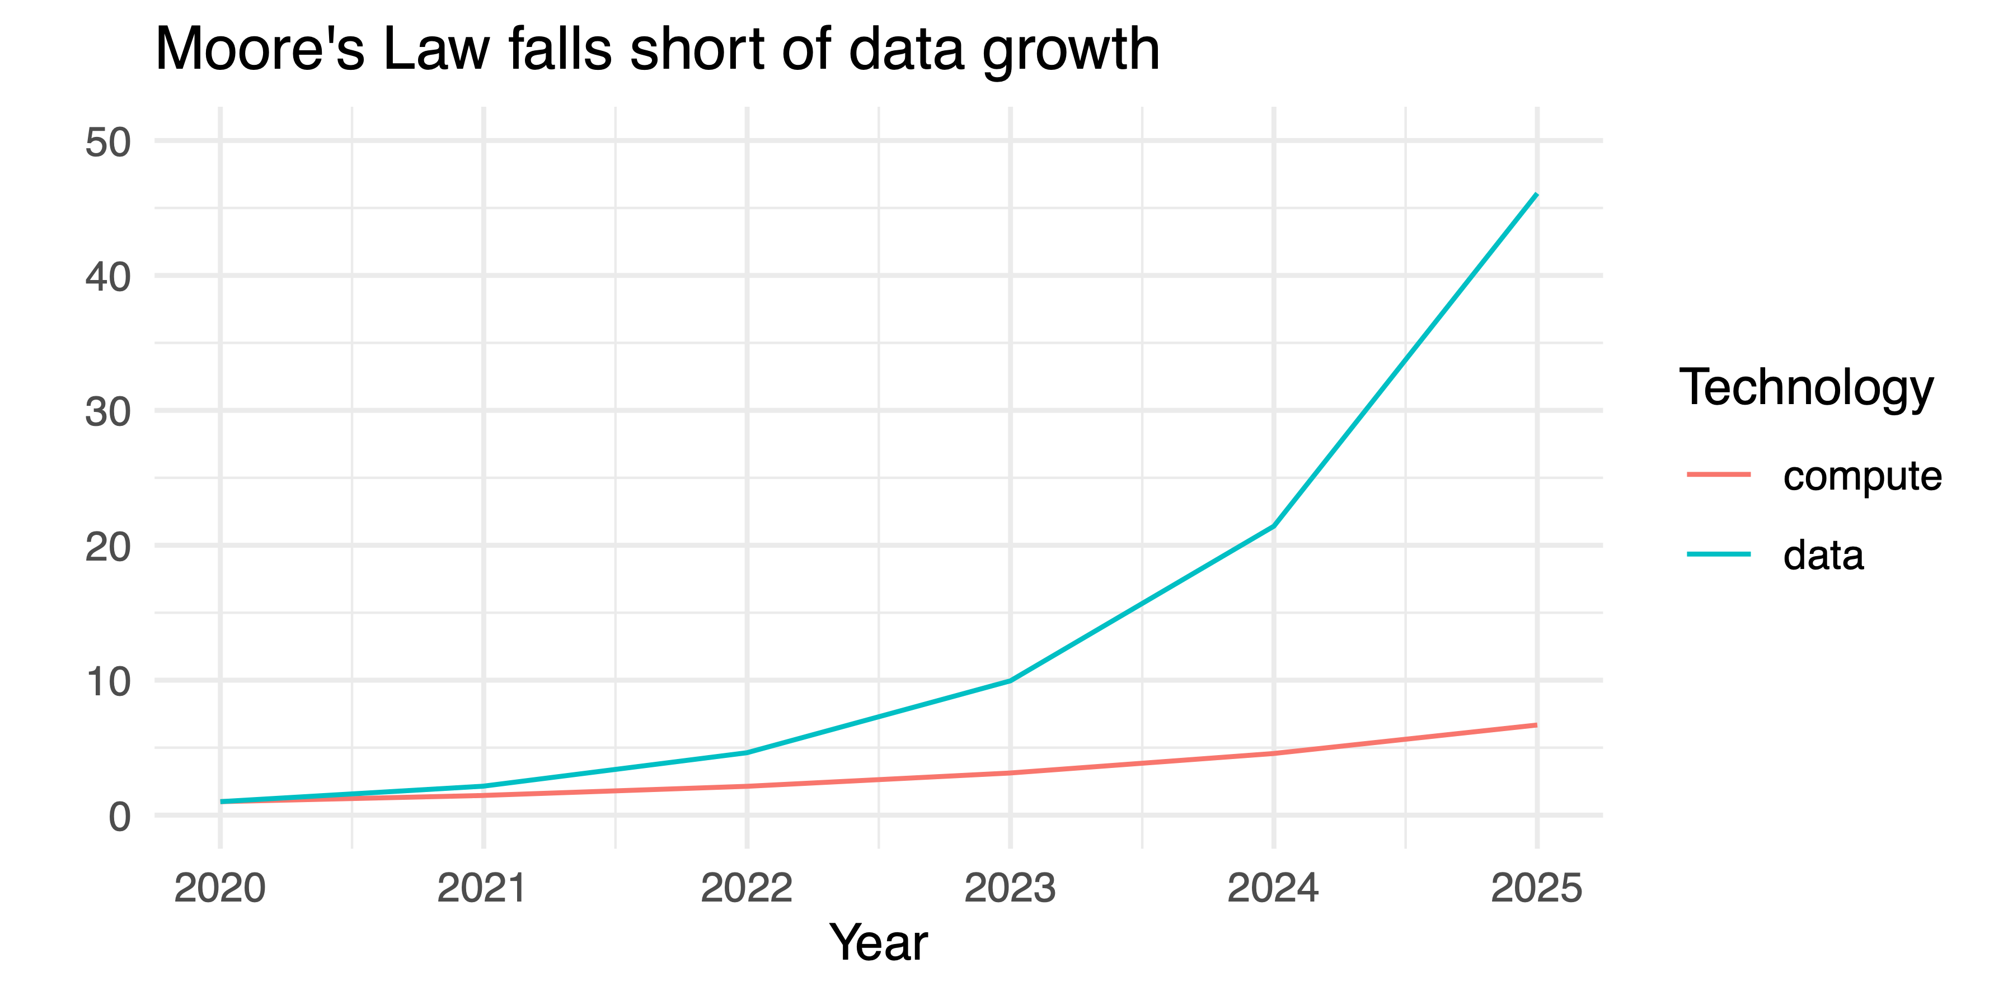
Moore's Law won't bail us out

Slide 23

Challenges
Data explosion
Unreproducible results

Slide 24
2. We no longer trust science

Slide 25
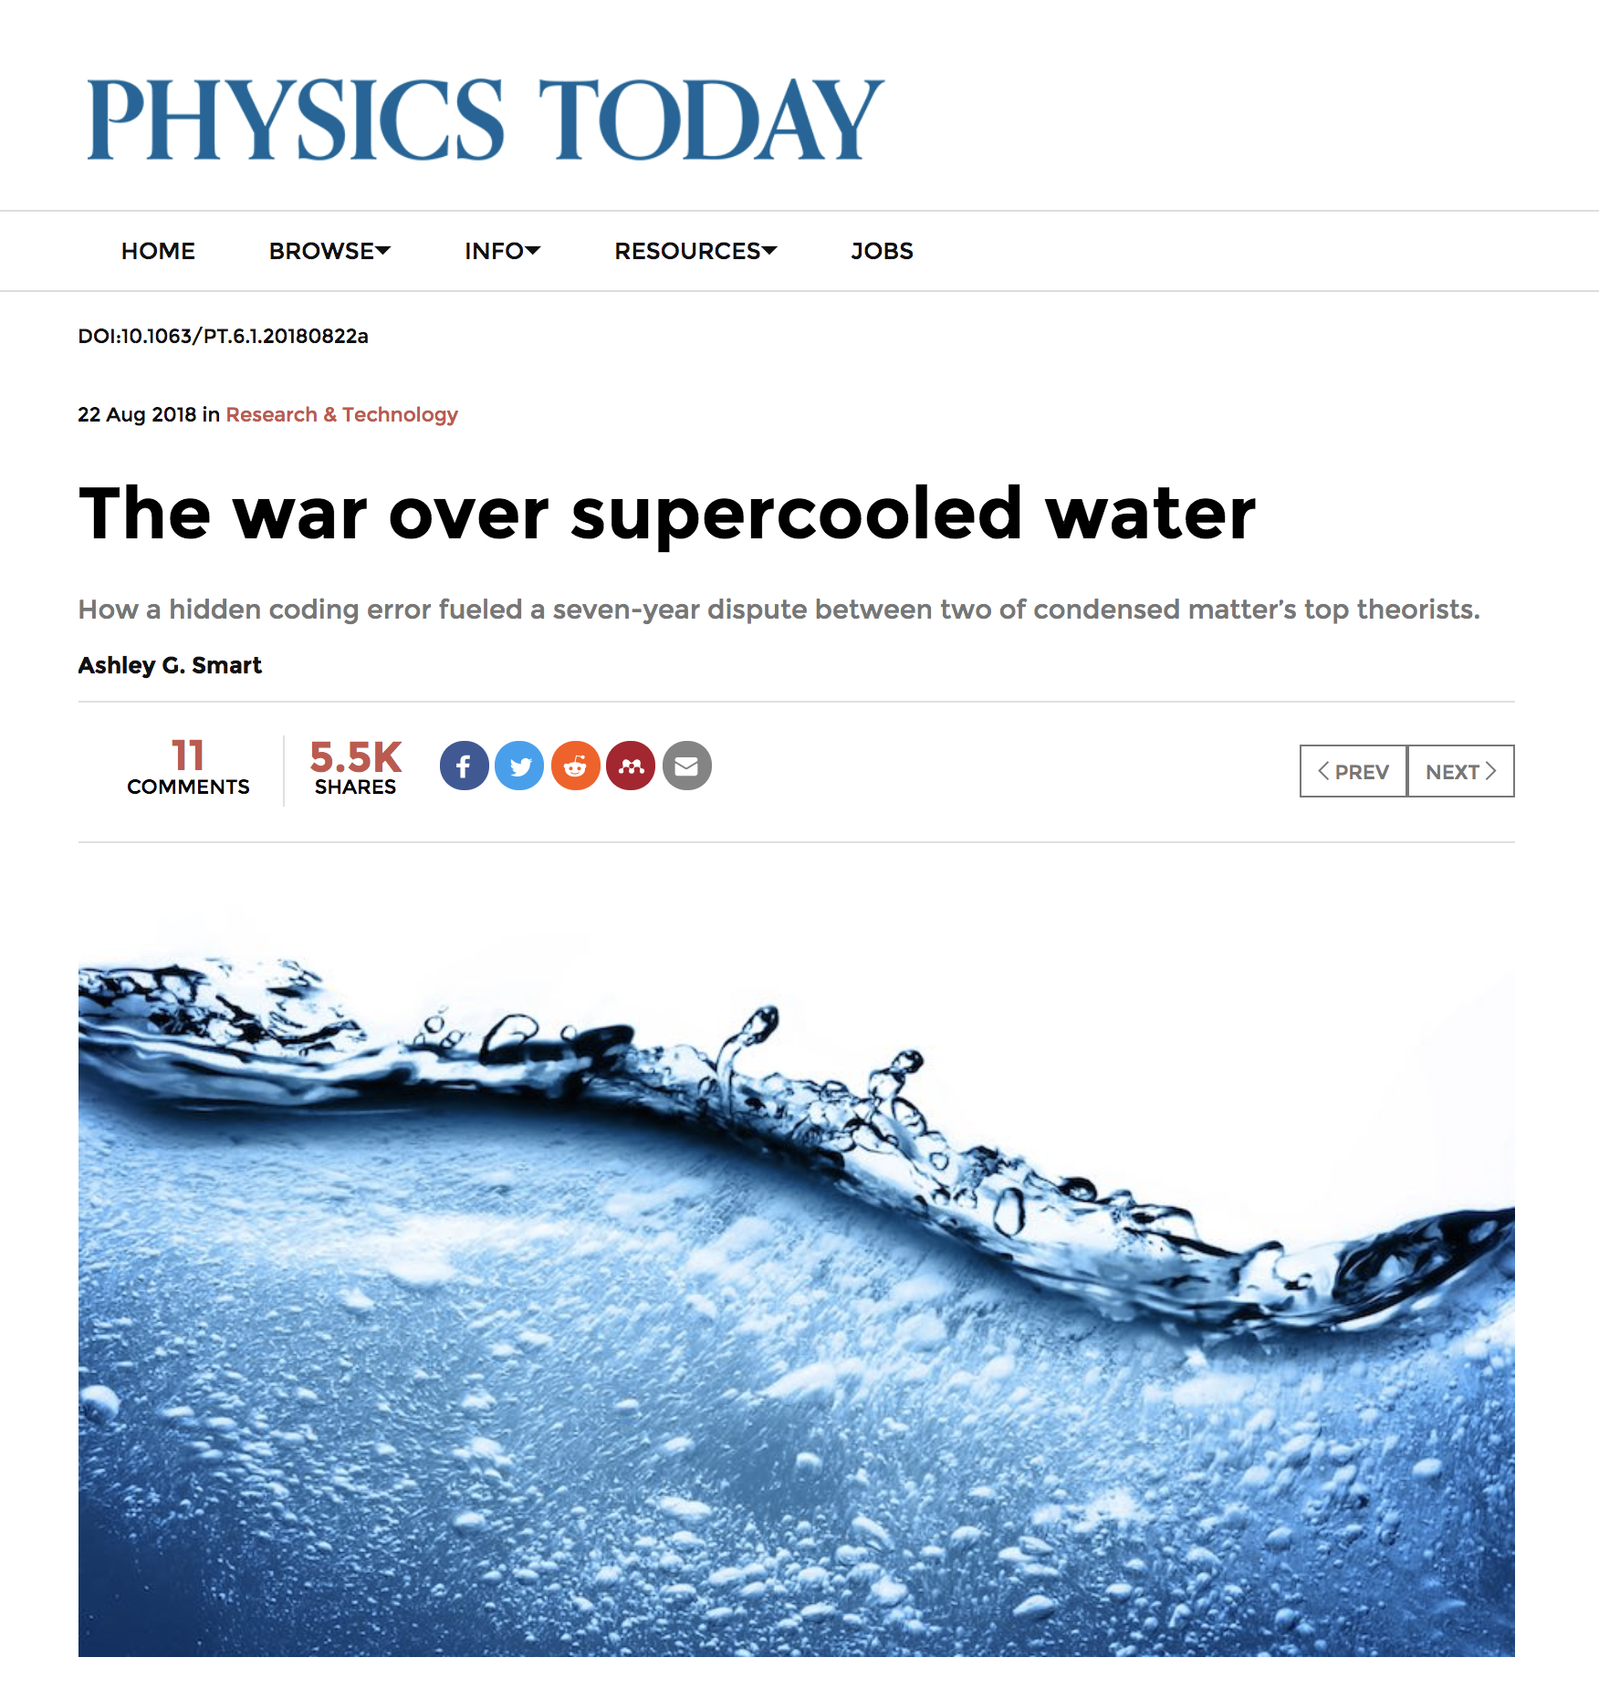
Which words do you associate with science?
http://bookdown.org/yihui/rmarkdown
Notes:
A couple of weeks ago, one of my colleagues sent me this article about physicists, and I was intrigued. You see there were these two teams of physicists who were both studying what happens to water when you freeze it. Its actually quite interesting; everyone knows that water freezes at 0 degrees celsius, but that's not really true. Water will freeze at 0 degrees if there are impurities in the water, like dust or dirt. Ice crystals will form around them. But if you remove all of the impurities, you can chill water to -20 degrees, maybe -40 degrees celsius without it turning into ice. When you do this, something interesting happens to the water —- maybe. We don't really know because its a bit hard to observe, but you can run computer models on it. And that's what these two groups of scientists did. One group was from Berkeley, and the other was from Princeton. They both used the same computer models for water, and they both used monte carlo simulations to see what would happen as water was supercooled. But one group found something extra-ordinary: that supercooled water can reform into a new type of liquid …sometimes… before it becomes ice. However, the other group found something hum-drum: supercooled water doesn't do anything special, it just turns to ice.
Who was right? At first the teams tried to work together to get to the bottom of things, but soon they were locked in an outright feud that lasted for seven years. The feud came to an end last month when one of the teams—through pleading, threatening, and appealing to a higher authority (in this case the journal Nature) got access to …what after seven years? The other team's code. And what did they find? A bug: water really might do something unusual, the simulation that said otherwise used bad code.
I like this story because it shows that code matters—and if you are doing science, your code can be as important as your conclusions.

Slide 26






Amgen 2012
Notes:
Amgen had recreated 53 landmark studies. Landmark is Amgen's term, but by that I mean that the studies were influential and that other studies had relied upon them.
Of these, Amgen was only able to replicate the results of…

Slide 27






Amgen 2012: could reproduce only 6 of 53 landmark results
75% 90%
of preclinical results cannot
be reproduced (estimate)
Begley CG, Ioannidis JP (2015) Reproducibility in Science: improving the standard for basic and preclinical research. Circ Res 116: 116–126. pmid:25552691
Notes:
six of the fifty three studies. And let me define what I mean by replicable. A study's results are replicable if you get them again when you repeat the study. This is a basic requirement for sound research: a study's conclusions are unlikely to be true if you get different results when you redo the study. Now look at how bad this is. In scientific terms, this means that the other studies may as well be wrong—in fact they probably are wrong. And yet they were all published in peer review journals and went unchallenged in academia.
In response to this announcement, Bayer Pharmaceuticals confirmed that they could only replicate about 25% of the studies that they reproduce. Since then, the issue has been studied in depth and our best estimate is that

Slide 28
75% 90%
−
−
−
−
−
−
−
−
−
−
−
−
−
−
−
−
−
−
−
−
of preclinical results cannot
be reproduced (estimate)
−
−
−
−
−
−
−
−
−
−
−
−
−
−
−
−
−
−
−
−
−
−
−
−
−
−
−
−
−
−
−
−
−
−
−
−
−
−
−
−
−
−
−
−
−
−
−
−
−
−
−
−
−
−
−
−
−
−
−
−
−
−
−
−
Begley CG, Ioannidis JP (2015) Reproducibility in Science: improving the standard for basic and preclinical research. Circ Res 116: 116–126. pmid:25552691
−
−
−
−
−
−
−
−
−
−
−
−
−
−
−
−
Psychology


36 of 100
Notes:
For example, a review of 100 important psychology studies found that only 36% of them had replicable results.
Nosek et al. (2015). Estimating the reproducibility of psychological science. Science, 349 (6251).

Slide 29
Nature
& Science
Economics
Psychology













✶

36 of 100
13 of 21
29 of 59
Notes:
A survey of 59 influential economics articles by the federal reserve board revealed that only 29 of the studies had results that could be replicated.

Slide 30
Economics
Nature
& Science
Coin Tosses
that were heads


Nosek et al. (2015). Estimating the reproducibility of psychological science. Science, 349, 6251.




Chang AC, Li P (2015) Is Economics Research Replicable?, Finance and Economics Discussion Series 2015-083. (Board of Governors of the Federal Reserve System, Washington, DC).







✶
Camerer, et al. (2018). Evaluating the replicability of social science experiments in Nature and Science between 2010 and 2015. Nature Human Behaviour, 2, 637–644.

29 of 59
13 of 21
12 of 21
Notes:
I flipped a coin 21 times and carefully documented the results. 12 of the 21 flips came up heads. Now after the previous slides, you're probably suspicious, but let me reassure you: these results are more or less replicable.
All kidding aside, do you see what this means? Take the best research from the best scientific journals and ask yourself, "Should you believe the results?" Well, you might flip a coin to decide.
And the public is catching on. Here are a couple of headlines that have appeared in the mainstream press.

Slide 31
Nosek et al. (2015). Estimating the reproducibility of psychological science. Science, 349, 6251.
Chang AC, Li P (2015) Is Economics Research Replicable?, Finance and Economics Discussion Series 2015-083. (Board of Governors of the Federal Reserve System, Washington, DC).
Camerer, et al. (2018). Evaluating the replicability of social science experiments in Nature and Science between 2010 and 2015. Nature Human Behaviour, 2, 637–644.
Economics
Nature
& Science
Coin Tosses
that were heads



Why Do So Many Studies Fail to Replicate?
- The New York Times, May 2016










✶

29 of 59
13 of 21
12 of 21
Notes:
I flipped a coin 21 times and carefully documented the results. 12 of the 21 flips came up heads. Now after the previous slides, you're probably suspicious, but let me reassure you: these results are more or less replicable.
All kidding aside, do you see what this means? Take the best research from the best scientific journals and ask yourself, "Should you believe the results?" Well, you might as well flip a coin to decide.
And the public is catching on. Here are a couple of headlines that have appeared in the mainstream press.

Slide 32
Economics
Nature
& Science
Coin Tosses
that were heads



Why Do So Many Studies Fail to Replicate?
- The New York Times, May 2016
Psychology's Replication Crisis is Running Out of Excuses
- The Atlantic, November 2018










✶

29 of 59
13 of 21
12 of 21

Slide 33
Why Do So Many Studies Fail to Replicate?
- The New York Times, May 2016
Psychology's Replication Crisis is Running Out of Excuses
- The Atlantic, November 2018
The Breakdown in Biomedical Research
- The Wall Street Journal, April 2017

Slide 34
Psychology's Replication Crisis is Running Out of Excuses
- The Atlantic, November 2018
The Breakdown in Biomedical Research
- The Wall Street Journal, April 2017
Notes:
And we can expect more headlines to come, which means that the replication crisis is a looming credibility crisis for anyone who does science.
And all of this is particularly relevant to you, as this last headline suggests. In some ways the Pharmaceutical Industry is the first hero of the crisis—they sounded the alarm. But in other ways the pharmaceutical industry is the first victim. We have good estimates of how much money is wasted in pharmaceutical industry on irreproducible research.

Slide 35
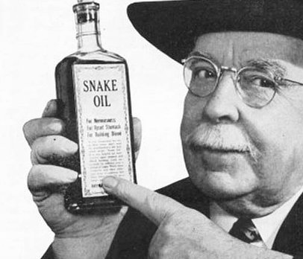
Credibility
$28 billion
The Breakdown in Biomedical Research
- The Wall Street Journal, April 2017
£ 22B € 24B
Costs to biomedical industry per year, US
Freedman LP, Cockburn IM, Simcoe TS (2015) The Economics of Reproducibility in Preclinical Research. PLoS Biol 13(6): e1002165. https://doi.org/10.1371/journal.pbio.1002165
Notes:
We estimate that $28 billion dollars is wasted each year in the United States on irreplicable biomedical research.
To put that in context, with $28 billion dollars, you could buy a latte…

Slide 36

$28 billion
£ 22B € 24B
Costs to biomedical industry per year, US
Freedman LP, Cockburn IM, Simcoe TS (2015) The Economics of Reproducibility in Preclinical Research. PLoS Biol 13(6): e1002165. https://doi.org/10.1371/journal.pbio.1002165
Notes:
for everyone on the planet…

Slide 37
75% 90%
of preclinical results cannot
be reproduced (estimate)
$28 billion
$
£ 22B € 24B
Costs to biomedical industry per year, US
Freedman LP, Cockburn IM, Simcoe TS (2015) The Economics of Reproducibility in Preclinical Research. PLoS Biol 13(6): e1002165. https://doi.org/10.1371/journal.pbio.1002165
Notes:
from Starbucks.
Or thought of another way, with $28 billion dollars we could buy everyone in this room…

Slide 38

Notes:
their own private island in the bahamas (assuming supplies last). And that is just the money wasted in one year. And only the money wasted in the United States. And it only applies to irreducible research in biomedicine. Unfortunately, all signs suggest that irreproducibility is a problem that affects all branches of science.

Slide 39

Challenges
Data explosion
Unreproducible results
Fake data

Slide 40
3. Data has become another way to lie

Slide 41
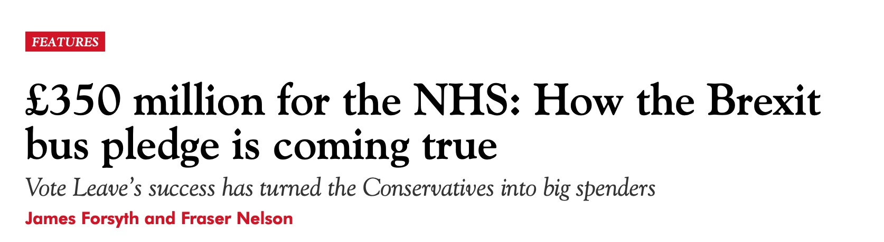
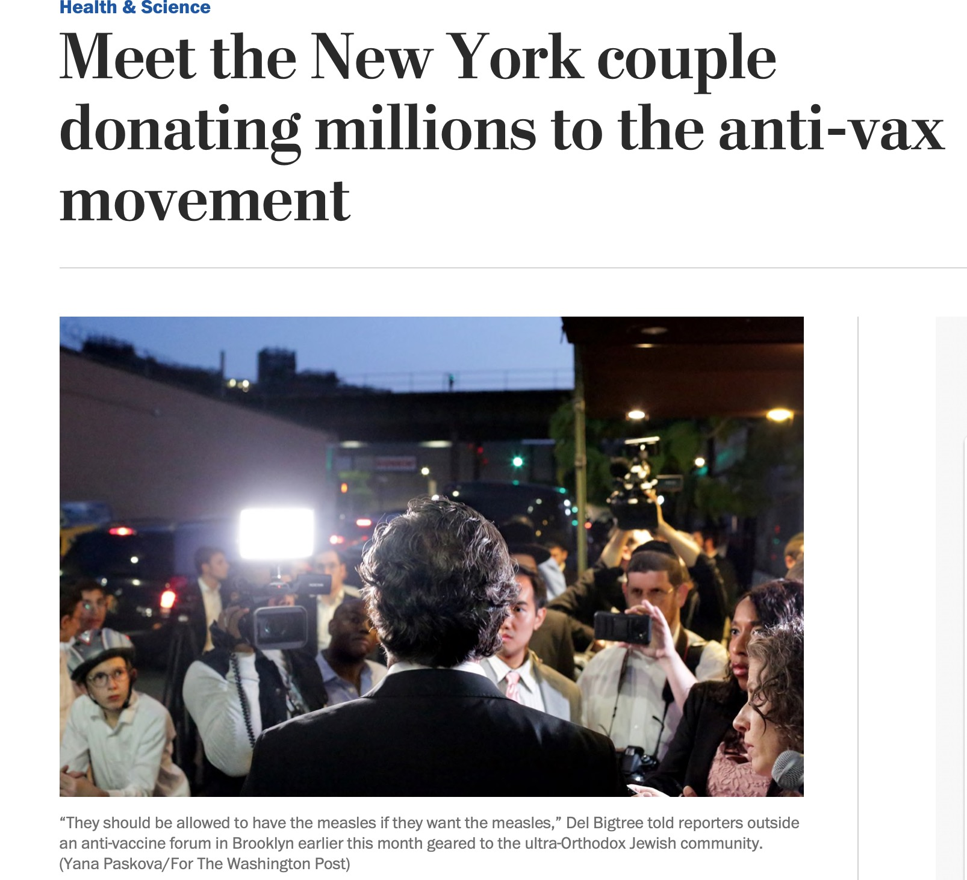
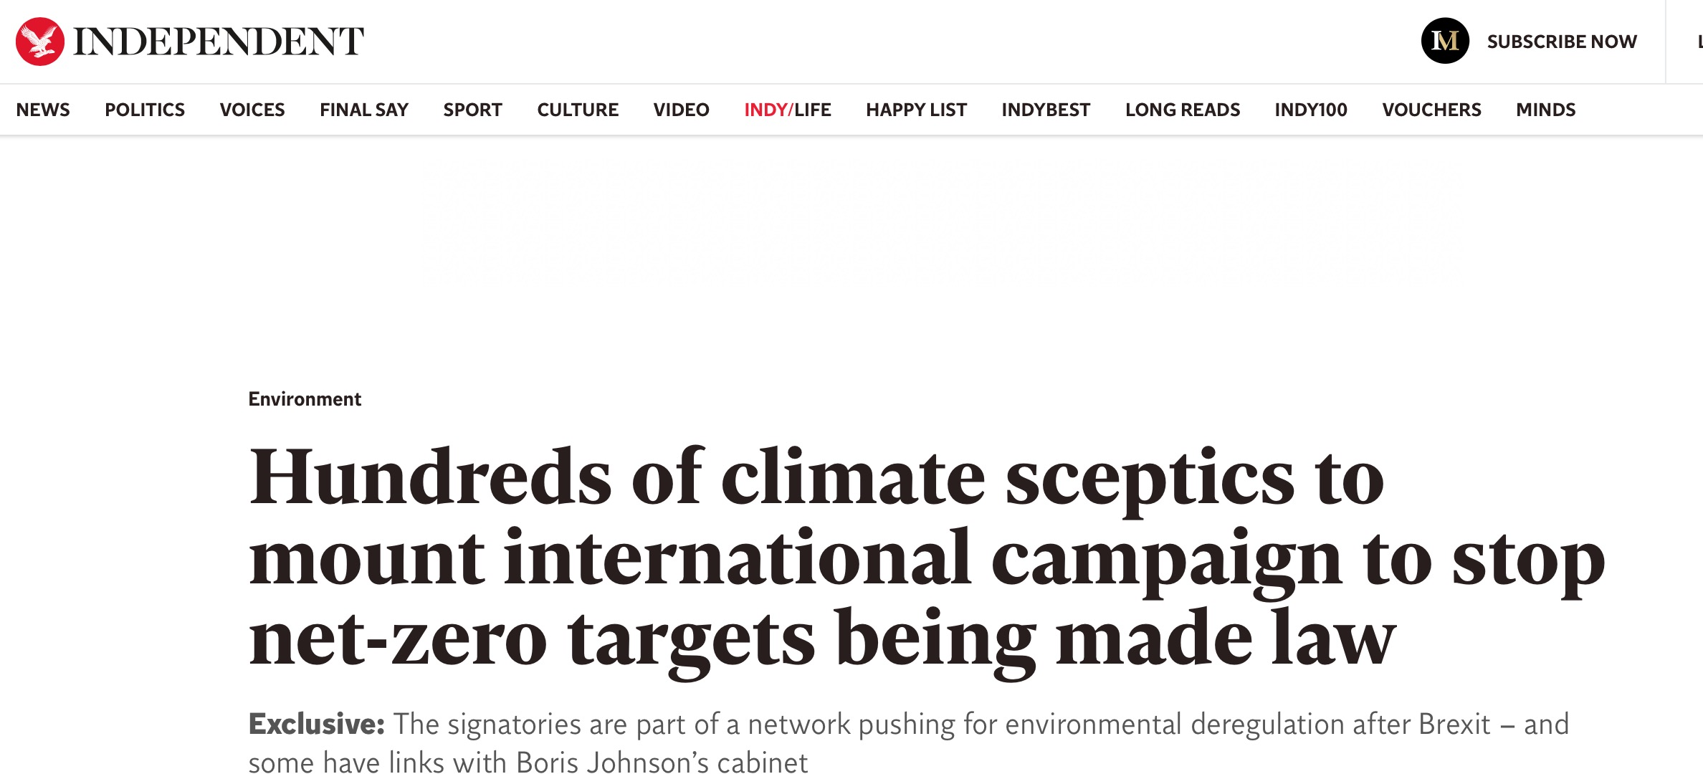

Slide 42
When people are overwhelmed or stressed, they stop listening to traditional media.
Instead they turn to their trusted sources....

Slide 43

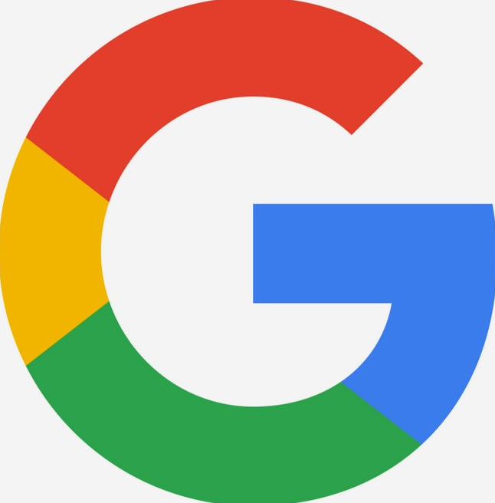


Slide 44
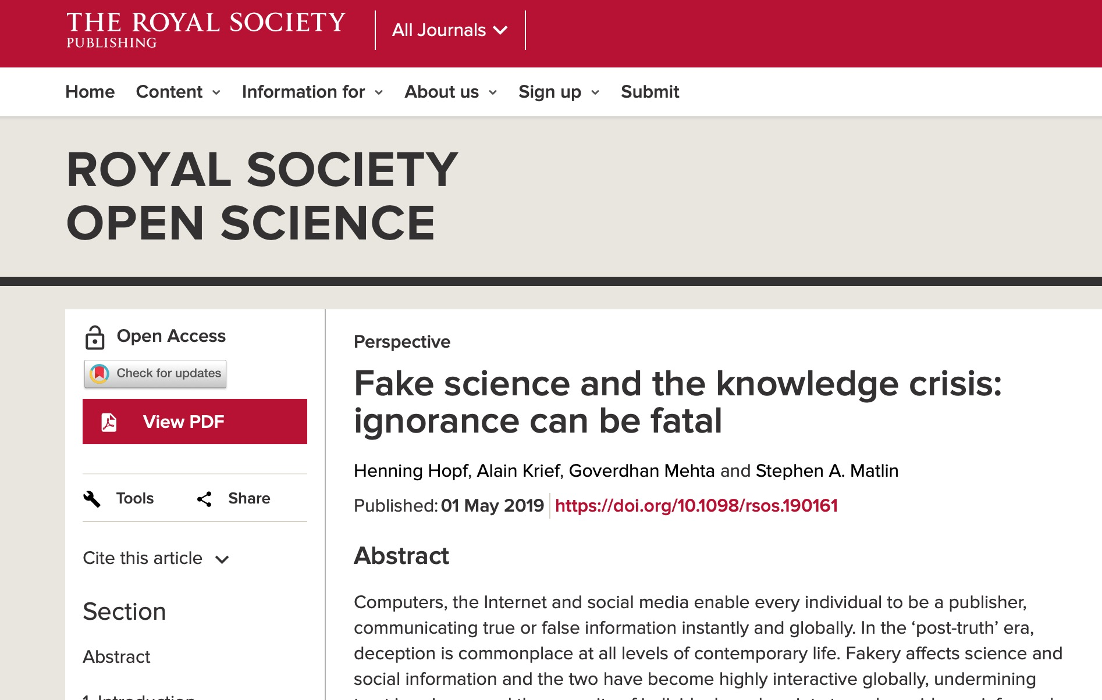

Slide 45
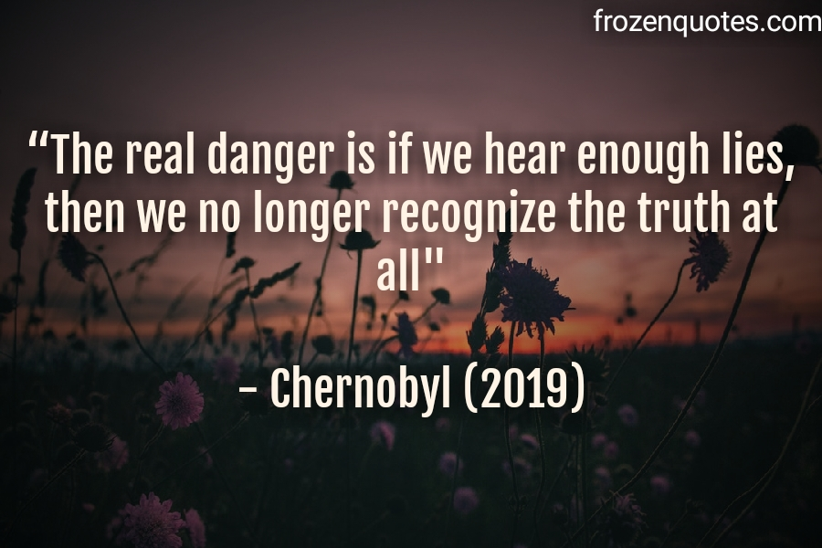

Slide 46
A true life example

Slide 47
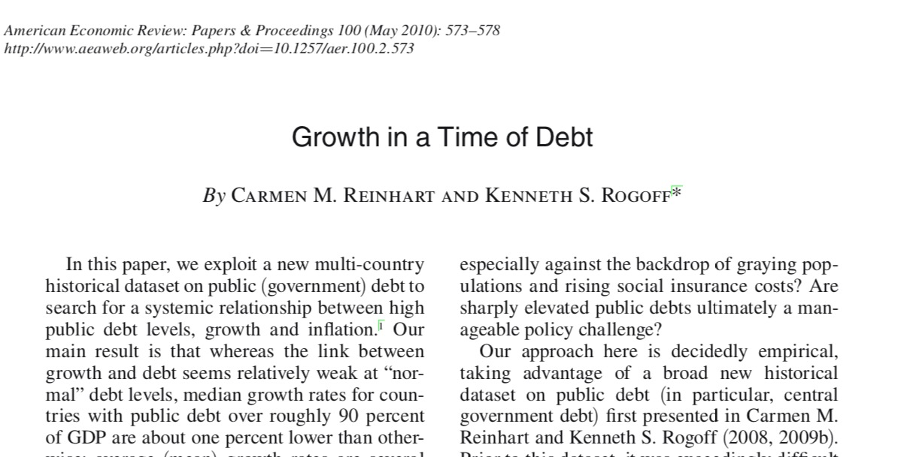
The Rogoff-Reinhart Model
Two Harvard Professors publish a paper that says "When a country owes more than 90 percent of its GDP, it slides into recession."

Slide 48
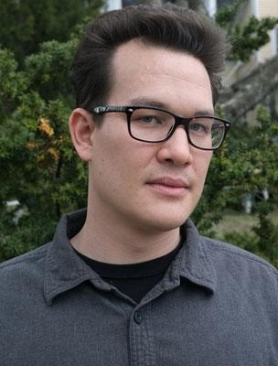
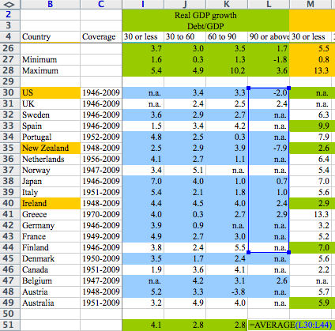

Thomas Herndon Discovered A Small Problem....

Slide 49
Rogoff and Reinhart's results weren't reproducible, yet they led to this....

Slide 50
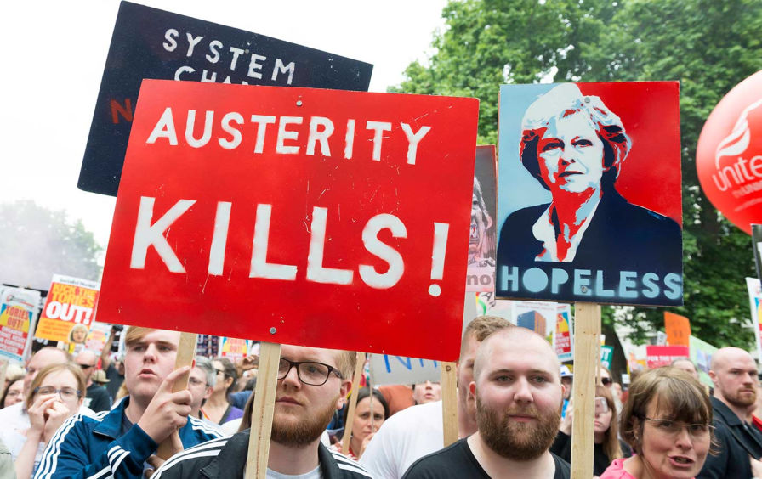

Slide 51
But we see hope

Slide 52
An analyst is just someone who reports the obvious
before anyone else does

Slide 53
Focus on teaching DATA science, not CODING science
https://github.com/rstudio/conf20-future-dse

Slide 54

Challenges
Changes
Data explosion
Embrace statistics
Unreproducible results
Fake data

Slide 55
1. Data science embraces
statistics on real data

Slide 56
Statistics because data is too big
Real data because the real world is messy

Slide 57
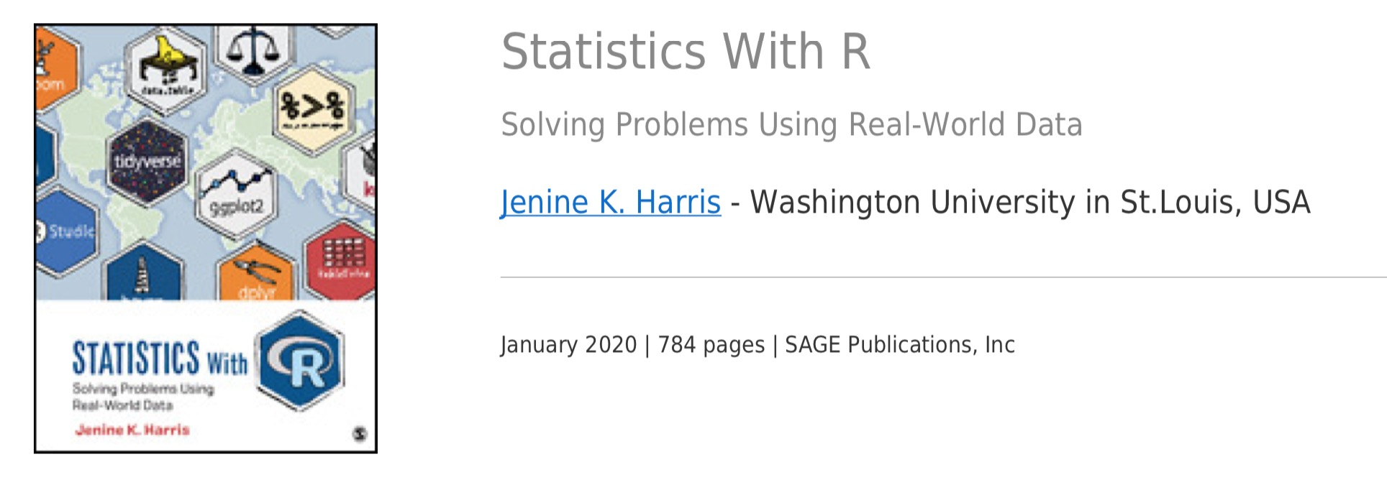

Slide 58

Challenges
Changes
Data explosion
Embrace statistics
Unreproducible results
Public processes
Fake data

Slide 59
2. Good data science relies on R Markdown computational documents and open processes

Slide 60
http://bookdown.org/yihui/rmarkdown
Notes:
That's the message of a book that I helped write this summer. Here's the book, it's called R Markdown: the Definitive Guide. R Markdown is a free R package that lets you run your analysis and generate your report from the same file. To understand R Markdown, think of an R script and a Microsoft Word Document having a baby, and then imagine that baby on steroids—really good steroids.
There are two things about this book that I'm very proud of.
First, the entire book is available for free online at this address.
Second, we made the hard copy of the book as cheap as possible. After we finished writing it, Yihui proposed an interesting idea to JJ and I. Basically, he had talked the publisher into reducing the price of the book by the amount they would normally pay us for a royalty. The only catch is that we would have to give up the royalty.
I can promise you that books are hard to write, and they do make money—even if you put them online for free, so it might seem odd, but we all agreed to forgo a royalty.
Why? Because we think R Markdown will solve the reproducibility crisis. If you haven't realized it yet, the reproducibility crisis is the one dark cloud in the bright future of data science. And its a darker cloud than you may think.

Slide 61
Curated data allows us to trust data
Computational documents allow us to see how that data was manipulated
Open source publishing of sources allows others to run our work

Slide 62

Challenges
Changes
Data explosion
Embrace statistics
Unreproducible results
Public processes
Fake data
Authoritative storytellers

Slide 63
3. We must democratize data science

Slide 64

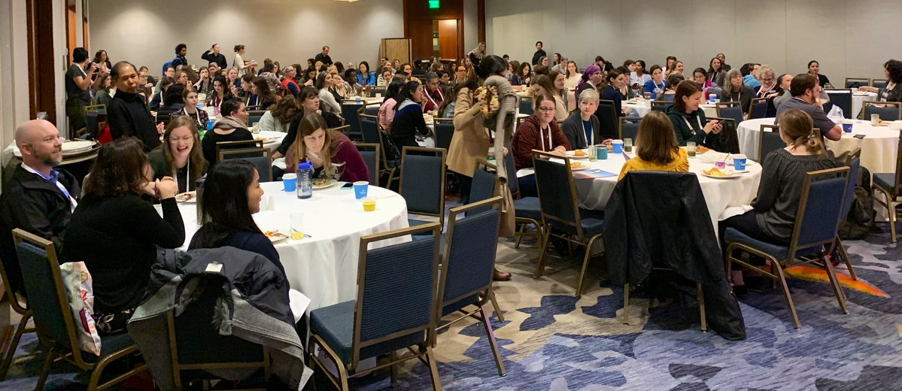

Slide 65
Our democratized experts must be viral storytellers

Slide 66
Who would you trust more to diagnose your illness?
A data scientist who learned some medicine?
A doctor who learned some data science?

Slide 67
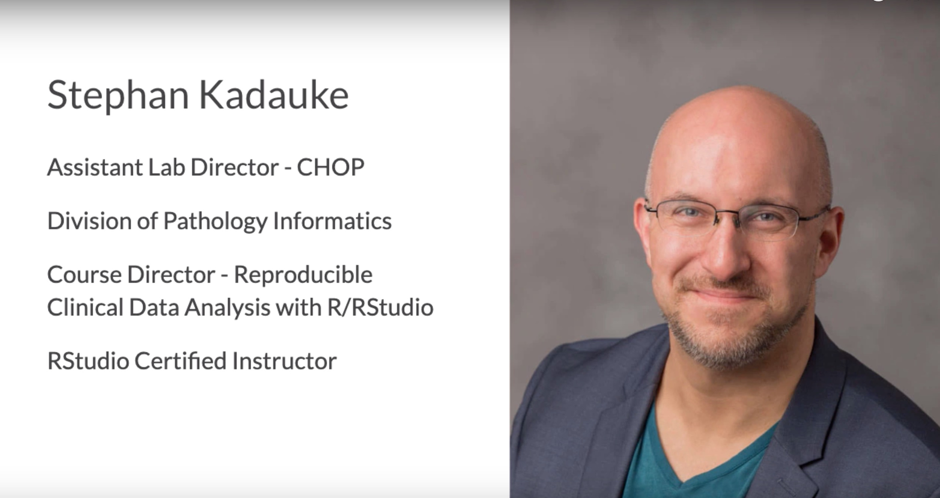

Slide 68

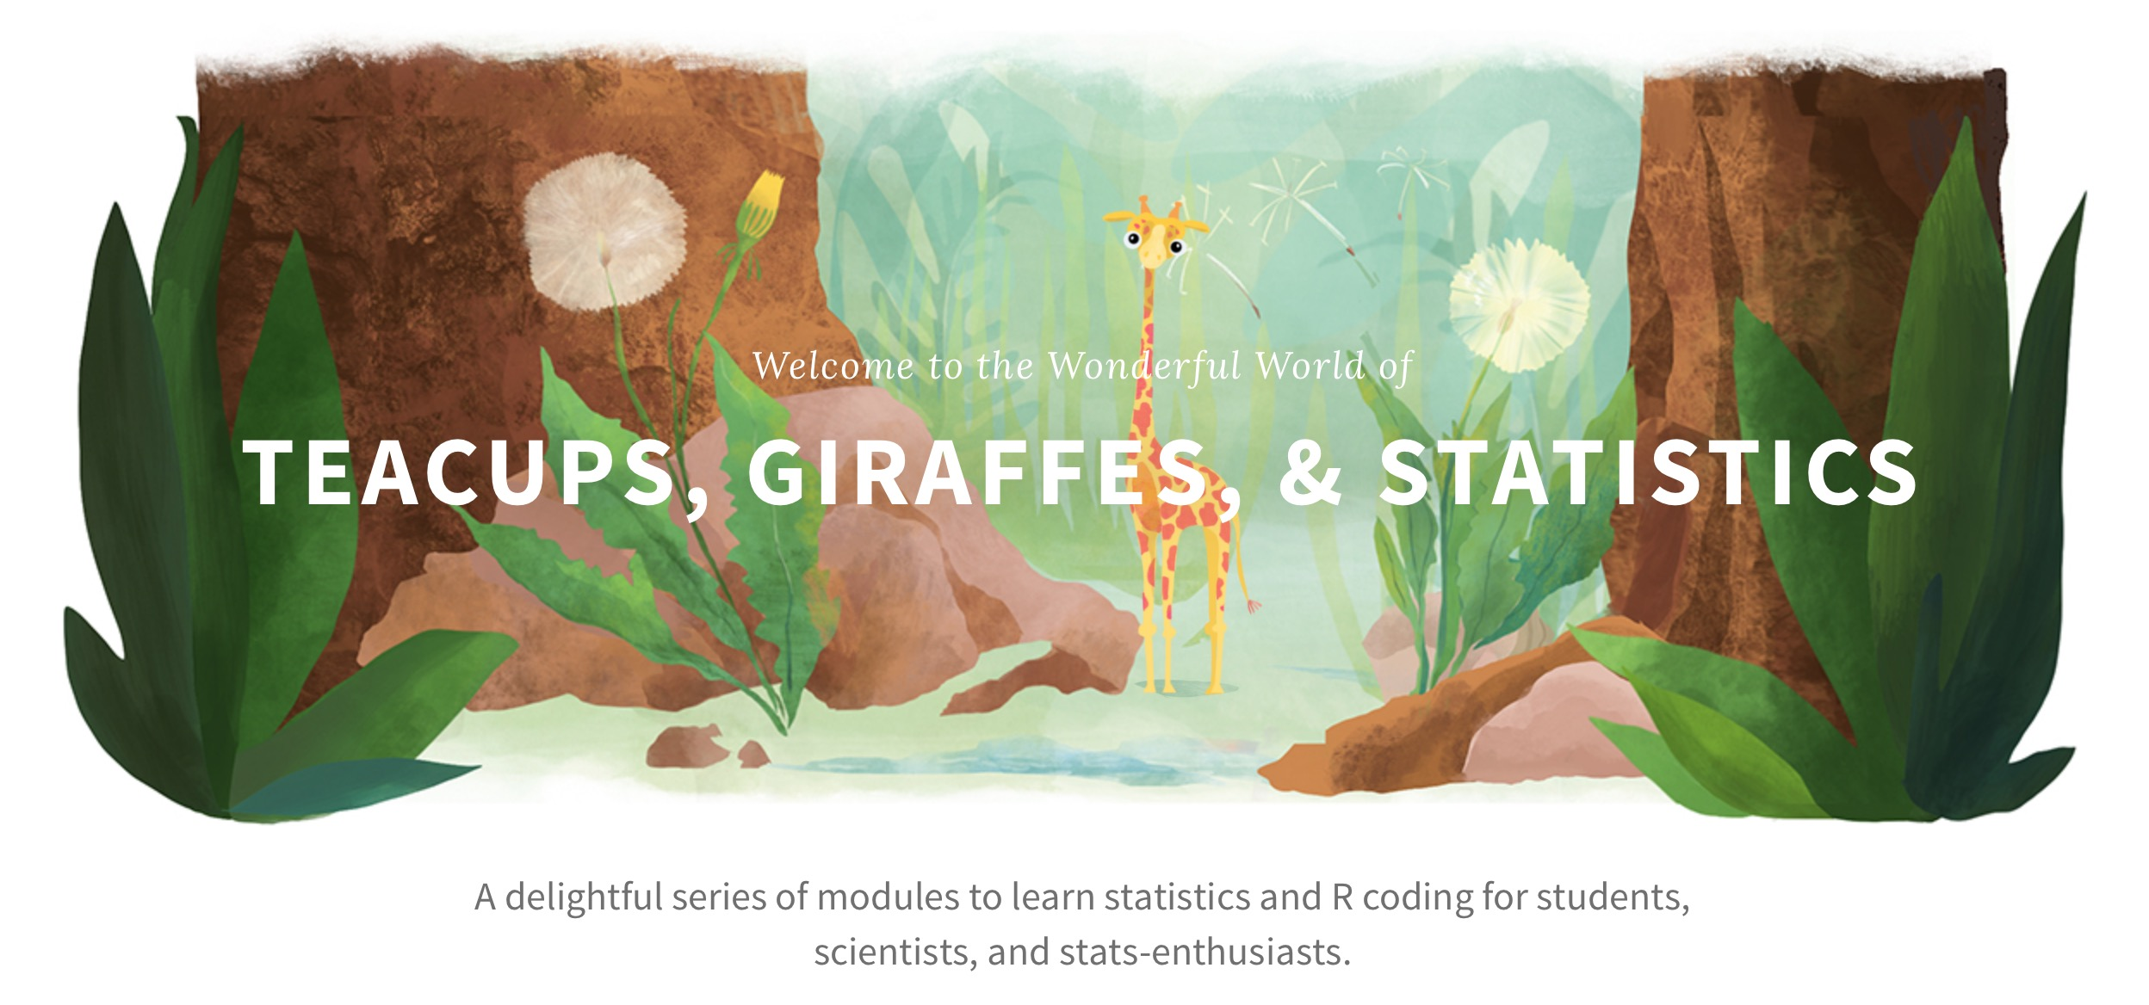

Slide 69
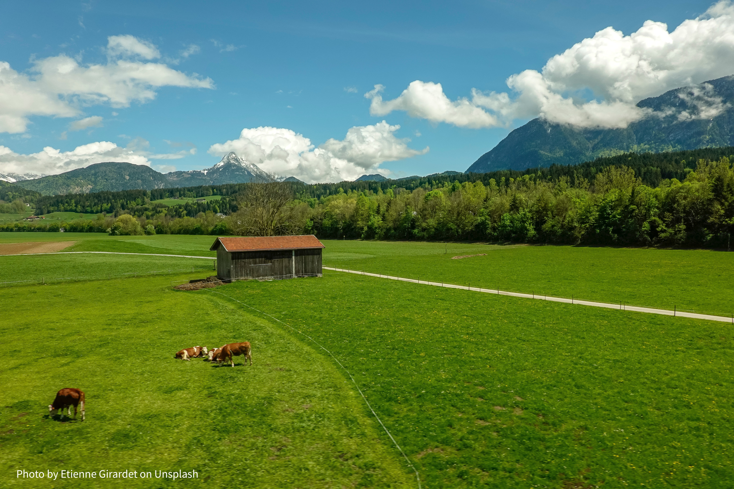

Slide 70
Challenges
Changes
Data explosion
Embrace statistics
Unreproducible results
Public processes
Fake data
Authoritative storytellers

Slide 71
We must focus on teaching DATA science, not CODING science
https://github.com/rstudio/conf20-future-dse

Slide 72
Too soon to tell, it is....

Slide 73
Each of you can help us overcome the new challenges in data science education

Slide 74
Help everyone, regardless of means, participate in a global economy that rewards data literacy

Slide 75
Materials at:
https://github.com/rstudio/conf20-future-dse

